Slide 1
Regression Analysis of the Salaries of Programmers and Engineers
TEAM: The Residuals
Adam Paredes
Jonathan Reggie Ebenezer
Jake Trenter
Atharva Kulkarni

Slide 2
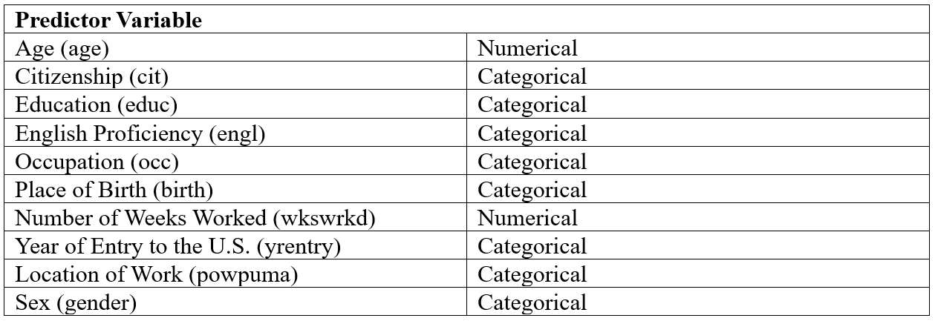
Intro to problem
This project will involve regression analysis of the salaries of programmers and engineers based on multiple different predictor variables

Slide 3
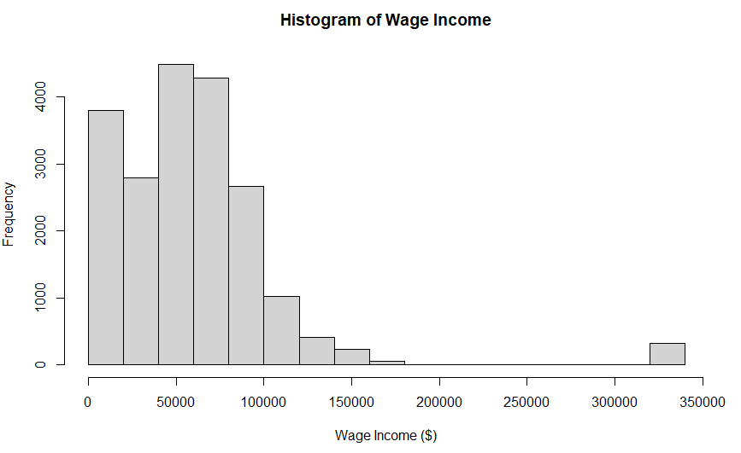
Response Variable: Wage Income (numerical)

Slide 4
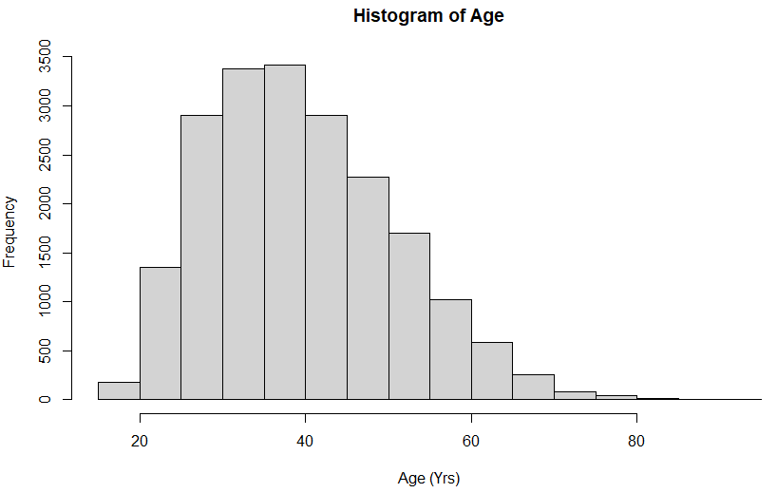
Predictor Variable: Age (numerical)

Slide 5
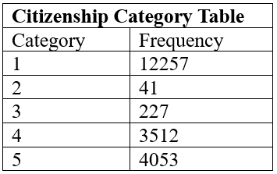
Predictor Variable: Citizenship (categorical)
Citizenship Categories:
Born in the US
Born in Puerto Rico or US territory
Born abroad to American citizens
Naturalized Citizen
Not a Citizen

Slide 6
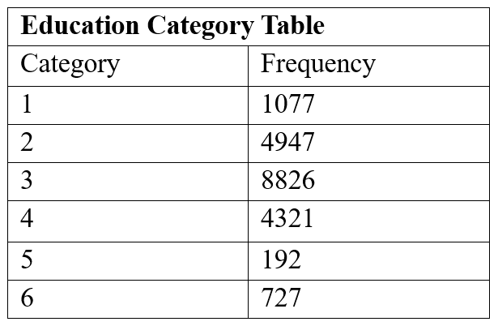
Predictor Variable: Education (categorical)
Education Categories:
1: no college
2: some college
3: bachelor’s degree
4: master’s degree
5: professional degree
6: doctorate

Slide 7
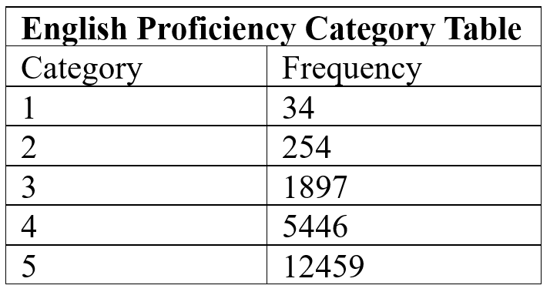
Predictor Variable: English Proficiency (categorical)
English Proficiency Categories:
Speaks Not at all
Speaks Not Well
Speaks Well
Speaks Very Well
Under 5 years or Speaks Fluently

Slide 8
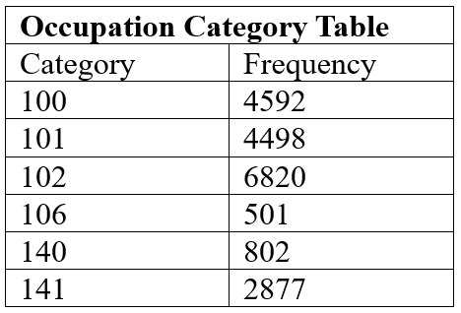
Predictor Variable: Occupation (categorical)
Occupation Categories:
100: Computer Scientists and Systems Analysts
101: Computer Programmers
102: Computer Software Engineers
106: Database Administrators
140: Computer Hardware Engineers
141: Electrical and Electronics Engineers

Slide 9
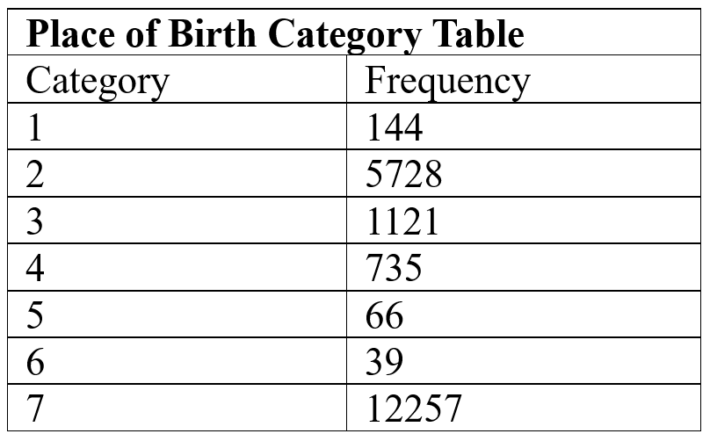
Predictor Variable: Place of Birth (categorical)
Place of Birth Categories:
Africa
Asia
Europe
Latin America
Oceania
U.S. Island Areas
United States

Slide 10
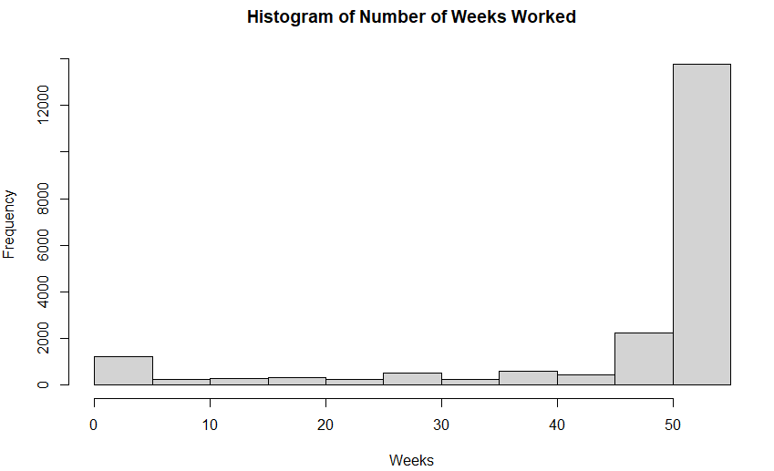
Predictor Variable: Number of Weeks Worked (numerical)

Slide 11
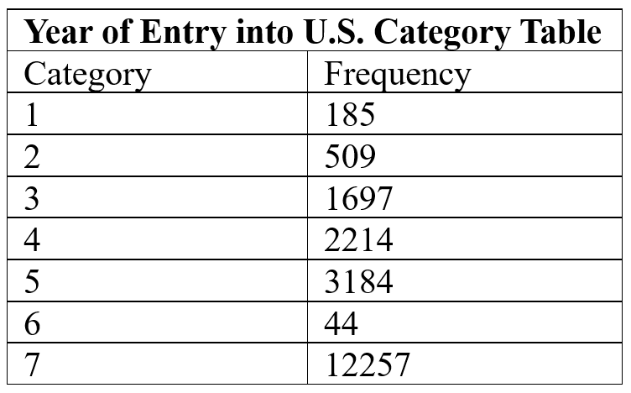
Predictor Variable: Year of Entry into U.S. (categorical)
Year of Entry Categories:
1951-1960
1961-1970
1971-1980
1981-1990
1991-2000
Before 1950
Native

Slide 12
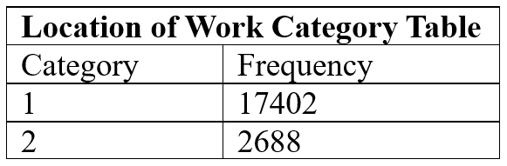
Predictor Variable: Location of Work (categorical)
Location of Work Categories:
California
Other
(Multiple work locations, so categories were restructured to simplify variable)

Slide 13
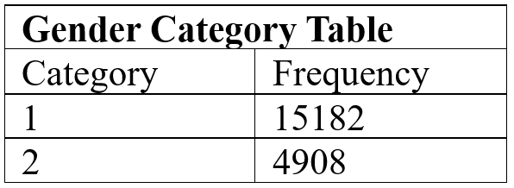
Predictor Variable: Sex (categorical)
Gender Categories:
Male
Female

Slide 14
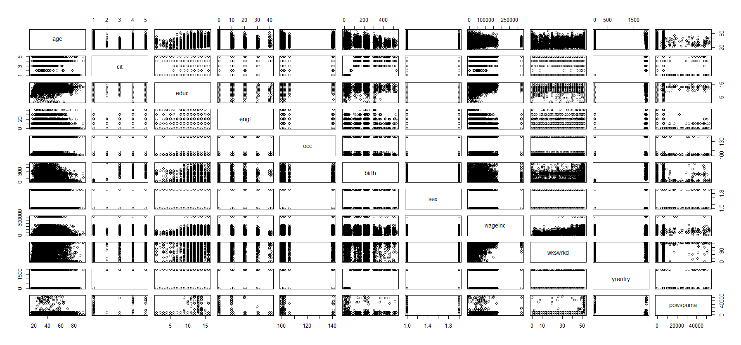
Initial Observations- Pairs

Slide 15
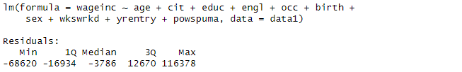
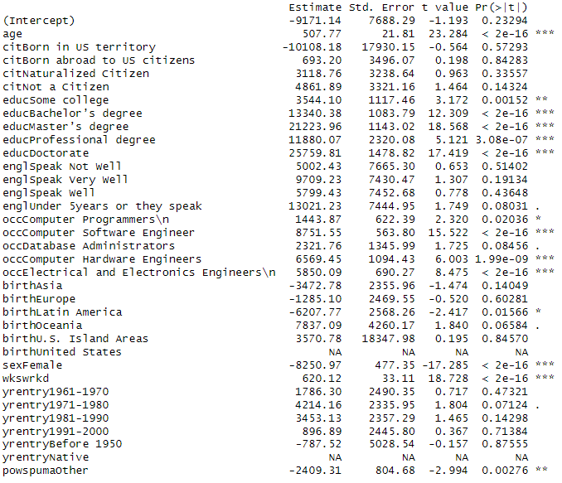
Fitting Initial Full Model
Full Model:
m <- lm(wageinc ~ age + cit + educ + engl + occ + birth + sex + wkswrkd + yrentry + powspuma, data=data1)
Response Variable: wageinc
Predictor Variables: age, cit, educ, engl, occ, birth, sex, wkswrkd, yrentry, and powspuma
No interaction terms included
No polynomial terms included
Top Code Removed for Max Wage Income

Slide 16
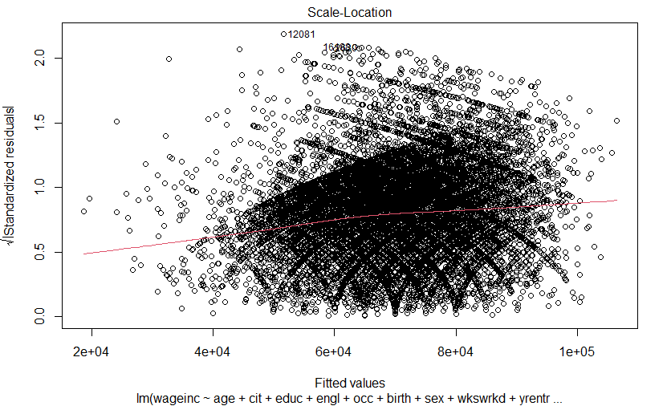
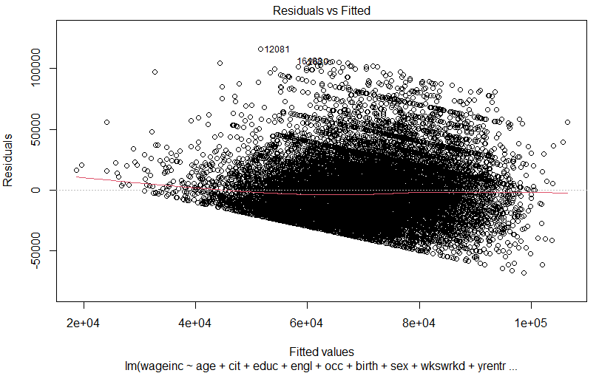
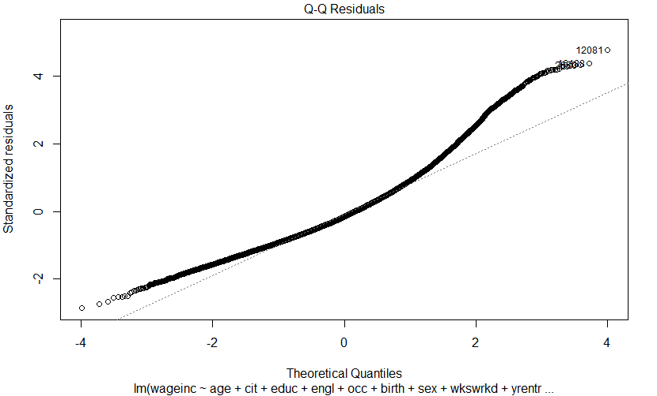
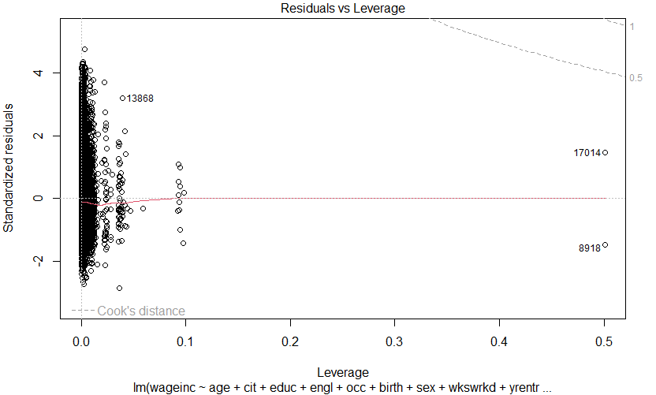
Full Model Diagnostics

Slide 17
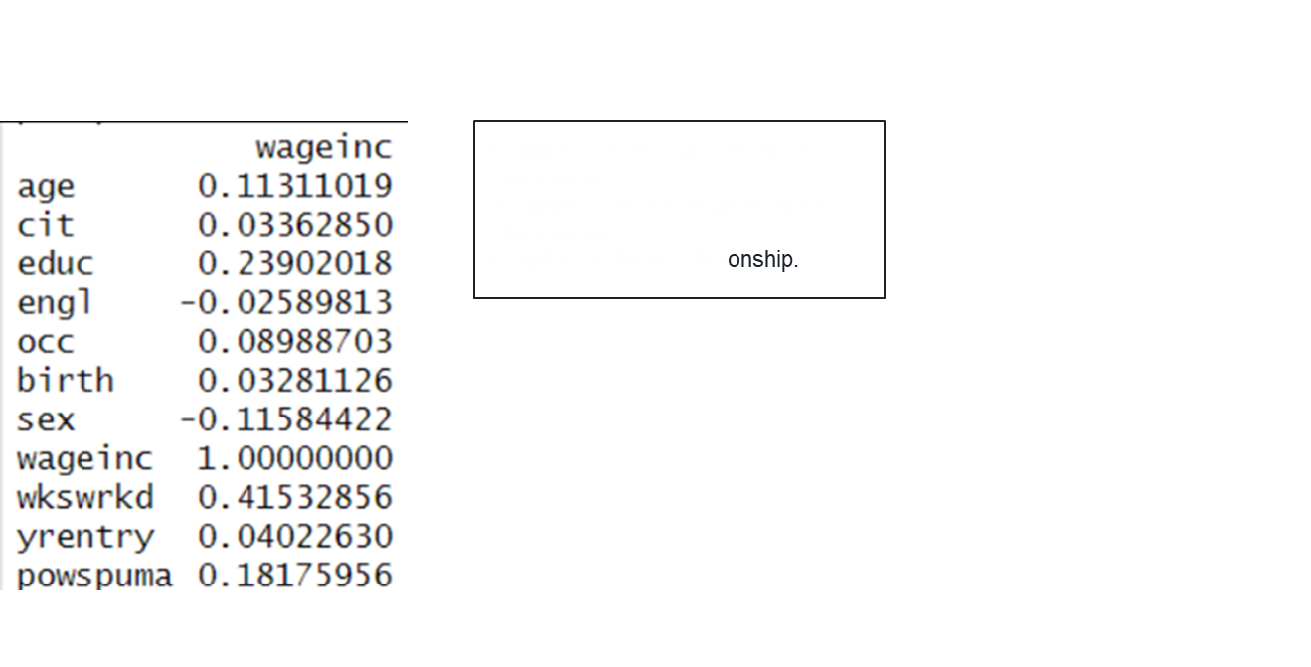
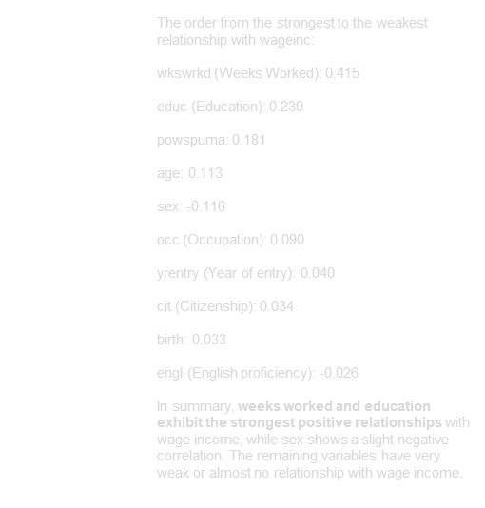

Slide 18

Reduced Model 1: Removing birth and yrentry
When running vif of the model we see that there is multicollinearity between birthplace, Year of entry, and citizenship. This makes sense since they are all correlated with citizenship (US born citizen would automatically have a 7 for year entry, and 7 for birth place).
Due to this we removed birth and year of entry and just maintained citizenship.

Slide 19
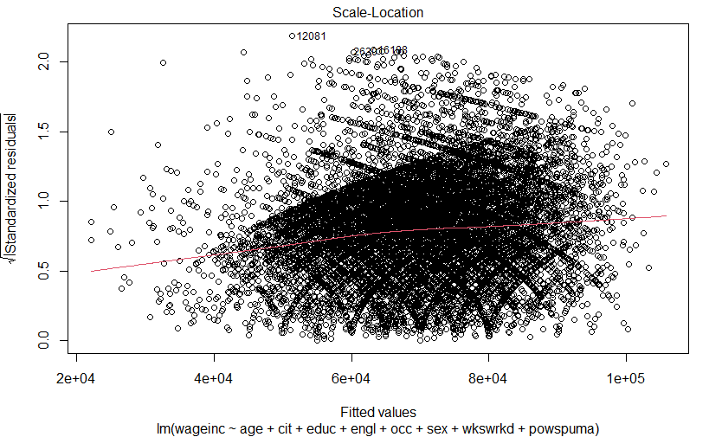
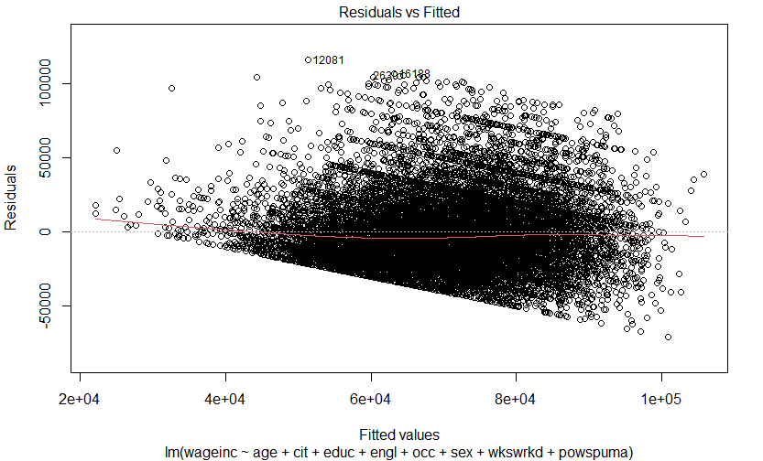
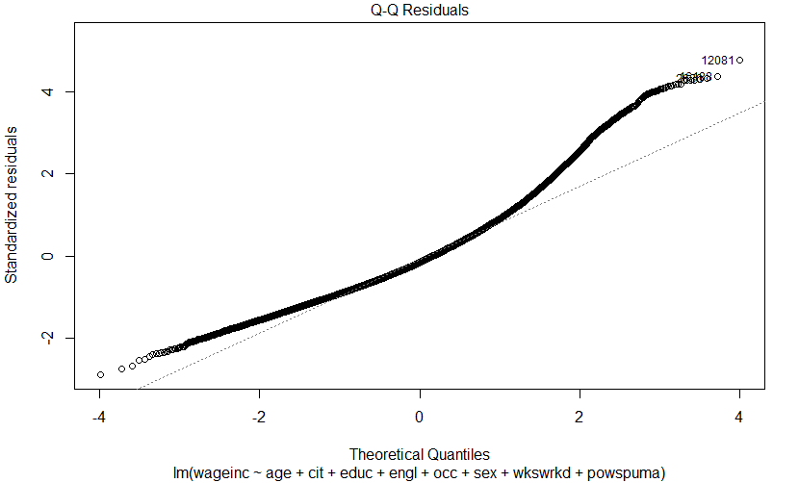
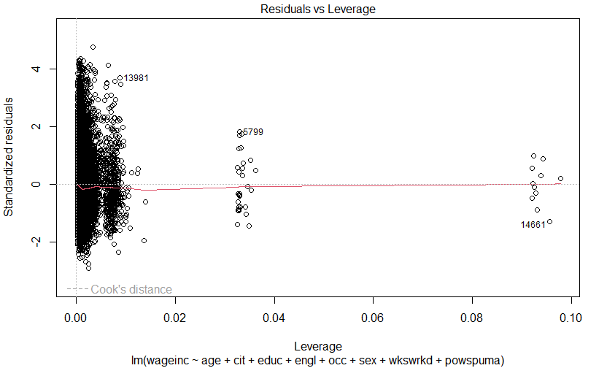
Reduced Model 1: Diagnostics

Slide 20
Reduced Model 2:
Justification for powspuma Removal
Reduced Model 1 (m2) (includes powspuma): R^2 adjusted = 0.1762227 AIC = 349214.6 BIC = 349397.6
Reduced Model 2 (m3) (removes powspuma): R^2 adjusted = 0.1758163 AIC = 349221.1 BIC = 349396.5
The adjusted R^2 barely changes after removing powspuma. This indicates that powspuma does not meaningfully improve the model’s ability to explain variability in wageinc.
The AIC is slightly lower for m2 by just 0.8 points. This difference is negligible and suggests no meaningful advantage in retaining powspuma in the model.
The BIC is slightly lower for m3 by about 6.8 points. A lower BIC favors simpler models, indicating that removing powspuma may be better in terms of model parsimony.
Removing powspuma simplifies the model, reduces potential overfitting, and has negligible impact on the model’s explanatory power. Thus, it is justified to remove powspuma.

Slide 21
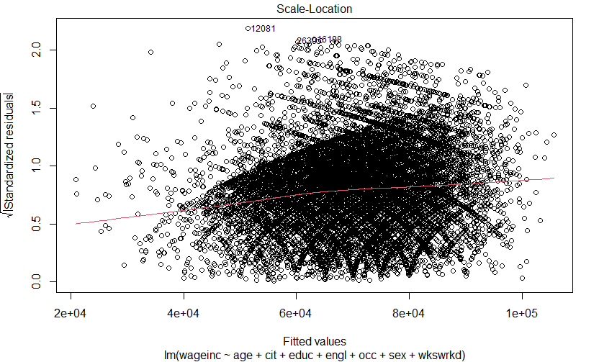
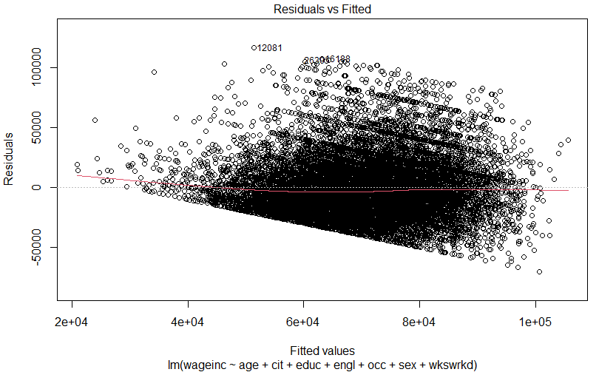
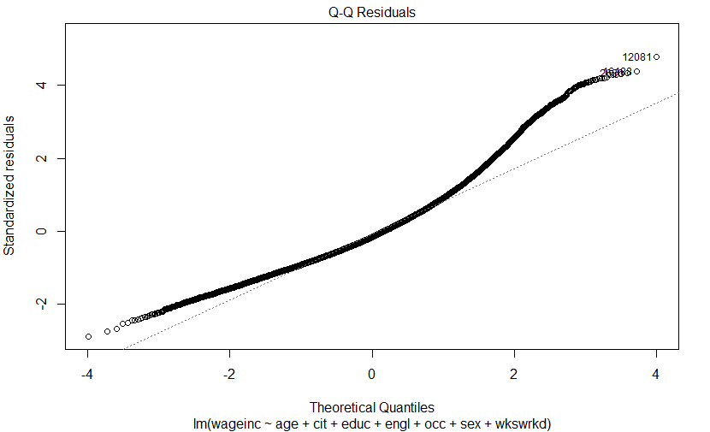
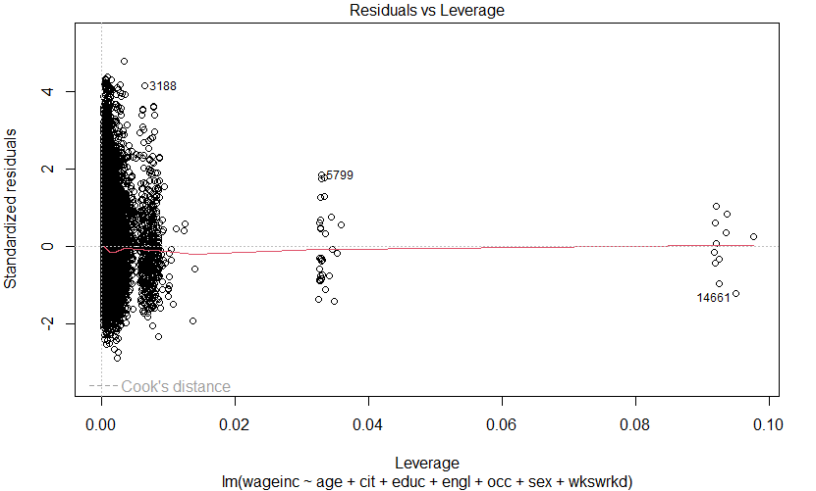
Reduced Model 2: Diagnostics

Slide 22
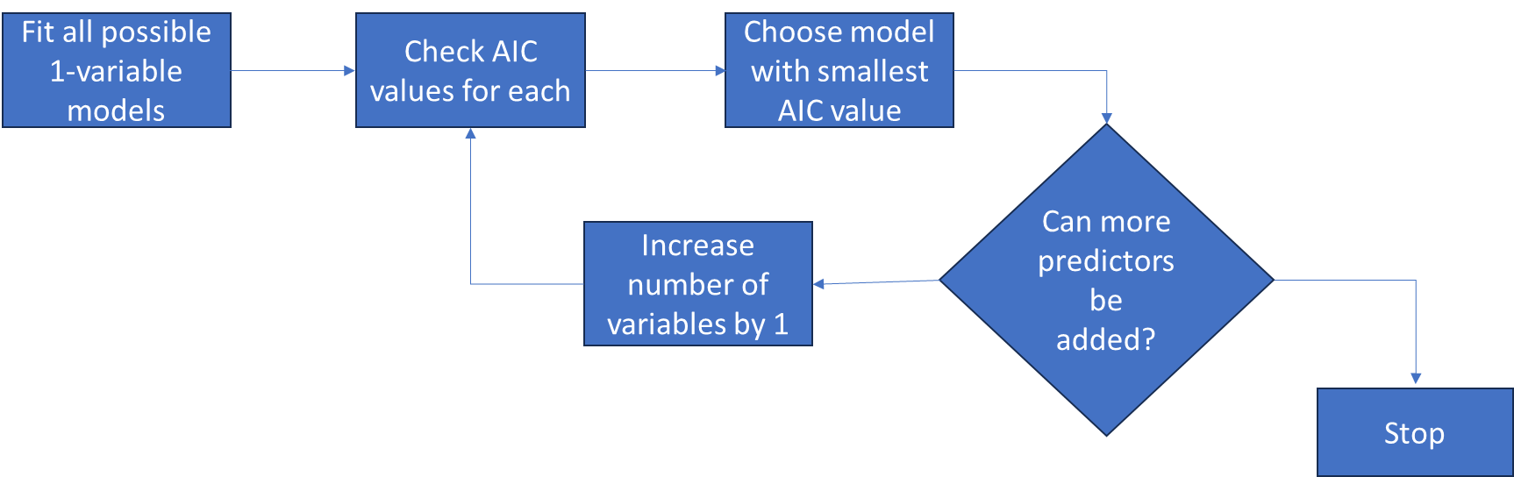
Checking AIC Models and Forward Selection
Y
N

Slide 23

Checking AIC of Single Variable Models
Reduced Model 1 (m2) (base model): AIC = 13527.48
Reduced Model 1 (m2) (includes age): AIC = 13057
Reduced Model 1 (m2) (includes cit): AIC =13487.4
Reduced Model 1 (m2) (includes educ): AIC = 12137.1
Reduced Model 1 (m2) (includes engl): AIC = 13506.17
Reduced Model 1 (m2) (includes occ): AIC =12849.48
Reduced Model 1 (m2) (includes sex): AIC =13153.59
Reduced Model 1 (m2) (includes wkswkrd): AIC = 13051.14

Slide 24
Checking AIC of Two Variable Models and Three Variable Models
Reduced Model 1 (m2) (includes educ+age): AIC = 11510.38
Reduced Model 1 (m2) (includes educ+cit): AIC = 12103.58
Reduced Model 1 (m2) (includes educ+engl): AIC =12029.9
Reduced Model 1 (m2) (includes educ+occ): AIC = 11762.62
Reduced Model 1 (m2) (includes educ+sex): AIC = 11790.95
Reduced Model 1 (m2) (includes educ+wkswrkd): AIC = 11603.14
Reduced Model 1 (m2) (includes educ+age+cit): AIC = 11513.81
Reduced Model 1 (m2) (includes educ+age+engl): AIC = 11462.42
Reduced Model 1 (m2) (includes educ+age+occ): AIC = 11073.11
Reduced Model 1 (m2) (includes educ+sex): AIC = 11132.33
Reduced Model 1 (m2) (includes educ+age+wkswrkd): AIC = 10977.6

Slide 25
Checking AIC of Four Variable Models and Five Variable Models
Reduced Model 1 (m2) (includes educ+age+wkswrkd+cit): AIC = 10973.9
Reduced Model 1 (m2) (includes educ+age+wkswrkd+engl): AIC = 10941.47
Reduced Model 1 (m2) (includes educ+age+wkswrkd+sex): AIC = 10594.58
Reduced Model 1 (m2) (includes educ+age+wkswrkd+occ): AIC = 10522.26
Reduced Model 1 (m2) (includes educ+age+wkswrkd+occ+sex): AIC = 10216.8
Reduced Model 1 (m2) (includes educ+age+wkswrkd+occ+cit): AIC = 10521.9
Reduced Model 1 (m2) (includes educ+age+wkswrkd+occ+engl): AIC = 10466.8

Slide 26
Checking AIC of Six Variable Models
Reduced Model 1 (m2) (includes educ+age+wkswrkd+occ+sex+cit): AIC = 10221.2
Reduced Model 1 (m2) (includes educ+age+wkswrkd+occ+sex+engl): AIC = 10171.1
Thus, the final selected model is as below.
"WAGEINC ~ Education + Age + Weeks Worked + Occupation + Sex + English Proficiency + Citizenship"

Slide 27
Including all Interaction Terms with Reduced Model
Rm<- lm(lnwageinc~(educ + age + wkswrkd + occ + sex + engl + cit)^2
+ I(age^2) + I(wkswrkd^2) + educ^2+ occ^2+ sex^2+ engl^2 + cit^2, data = data1)
IT INCLUDES:
BASE PREDICTOR TERMS | POLYNOMIAL TERMS | INTERACTION TERMS
educ age wkswrkd occ sex engl cit | educ^2 age^2 wkswrkd^2 occ^2 sex^2 engl^2 cit^2 | educ:age, educ:wkswrkd, educ:occ, educ:sex, educ:engl, educ: cit, age:wkswrkd, age:occ, age:sex, age: engl, age:cit, wkswrkd:occ, wkswrkd:sex, wkswrkd:engl, wkswrkd:cit, occ:sex, occ:engl, occ:cit, sex:engl, sex:cit, engl:cit

Slide 28
Eliminating Interaction Terms
Reduced Model-FORWARD: lnwageinc ~ educ + age + I(wkswrkd^2) + occ + I(age^2) +sex + engl + cit + wkswrkd + occ:cit + sex:cit + educ:occ +occ:wkswrkd + educ:wkswrkd + age:cit + educ:sex +sex:wkswrkd + age:sex
Rm_forward<-step(m7_null, scope = ~ (educ + age + wkswrkd + occ + sex + engl + cit)^2 + I(age^2) +I(wkswrkd^2) + educ^2+ occ^2+ sex^2+ engl^2+ cit^2, direction = "forward")
Reduced Model-BACKWARD: lnwageinc ~ educ + age + wkswrkd + occ + sex + engl +
cit + I(age^2) + I(wkswrkd^2) + educ:occ + wkswrkd:occ +
age:engl + age:sex + sex:cit + occ:cit + age:cit + educ:sex +
educ:wkswrkd + wkswrkd:engl + wkswrkd:sex
Rm_backward<-step(m7, direction=backward)
Reduced Model-BOTH: lnwageinc ~ educ + age + wkswrkd + occ + sex + engl +
cit + I(age^2) + I(wkswrkd^2) + educ:occ + wkswrkd:occ +
age:engl + age:sex + sex:cit + occ:cit + age:cit + educ:sex +
educ:wkswrkd + wkswrkd:engl + wkswrkd:sex
Rm_both<-step(m7, direction='both')

Slide 29
Reduced Model with Less Interaction Terms
ELIMINATION MODEL | AIC | ADJUSTED R^2
FORWARD DIRECTION | 9571.145 | 0.2348677
BACKWARD DIRECTION | 9571.578 | 0.2344882
BOTH DIRECTION | 9571.578 | 0.2344882
BEST FIT MODEL
lnwageinc ~ educ + age + wkswrkd + occ + sex + engl + cit + age^2 + wkswrkd^2 + educ:occ + wkswrkd:occ + age:engl + age:sex + sex:cit + age:cit + educ:sex + educ:age +sex:engl+ occ:cit+ educ:wkswrkd + wkswrkd:engl +wkswrkd:sex
ADJUSTED R^2 | AIC
0.2351495 | 9574.934
ADJUSTED R^2 - Useful for explaining variance(prediction accuracy).[HIGHER VALUE PREFERRED}
AIC - Useful for finding the simplest model with good performance.[LOWER VALUE PREFERRED]

Slide 30


REDUCED BEST MODEL: Rm_best<-lm(lnwageinc ~ educ + age + wkswrkd + occ + sex + engl + cit + age^2 + wkswrkd^2 + educ:occ + wkswrkd:occ + age:engl + age:sex + sex:cit + age:cit + educ:sex + educ:age +sex:engl+ occ:cit+ educ:wkswrkd + wkswrkd:engl +wkswrkd:sex, data = data1)
Base model:
Fm<-lm(wageinc ~age + cit + educ + engl + occ + birth +
sex + wkswrkd + yrentry + powspuma, data = data1)

Slide 31
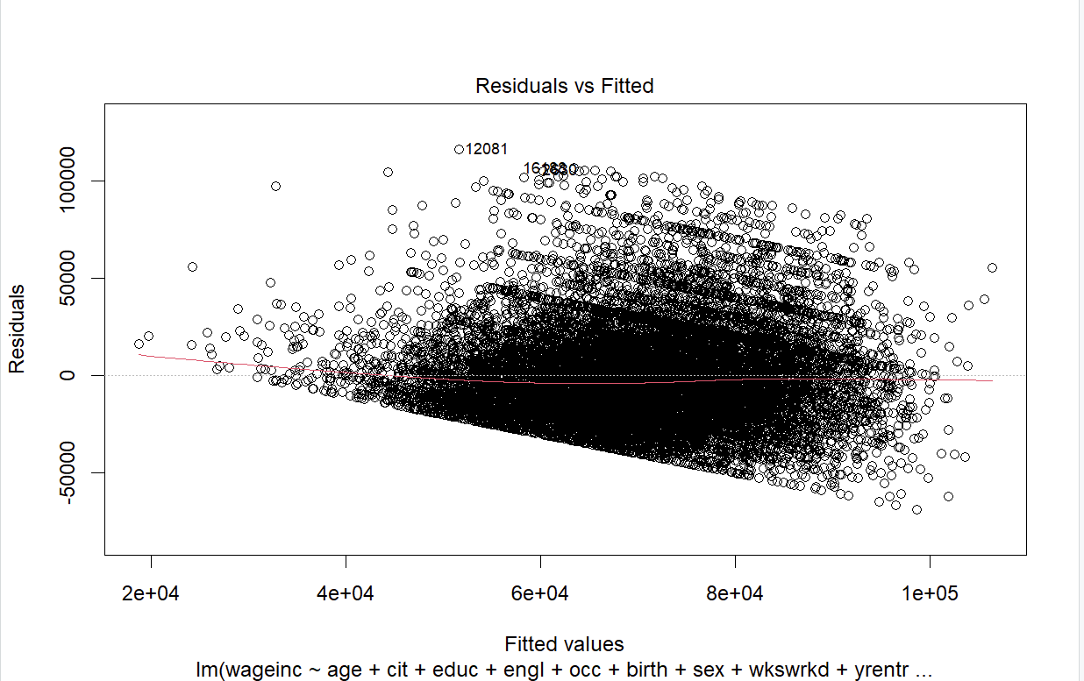
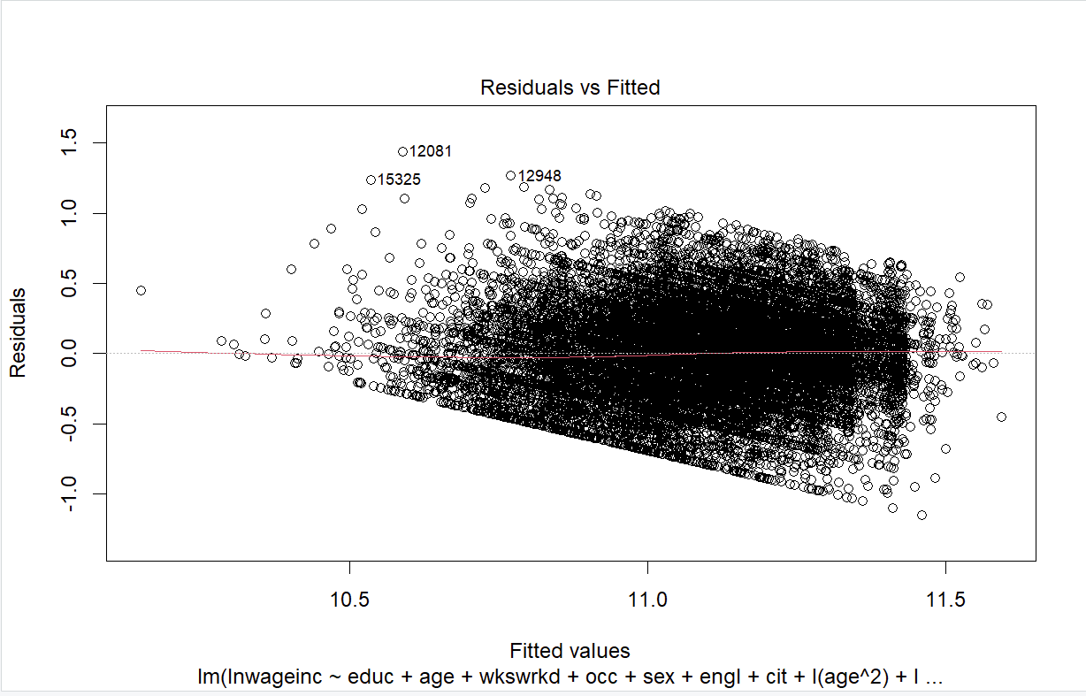
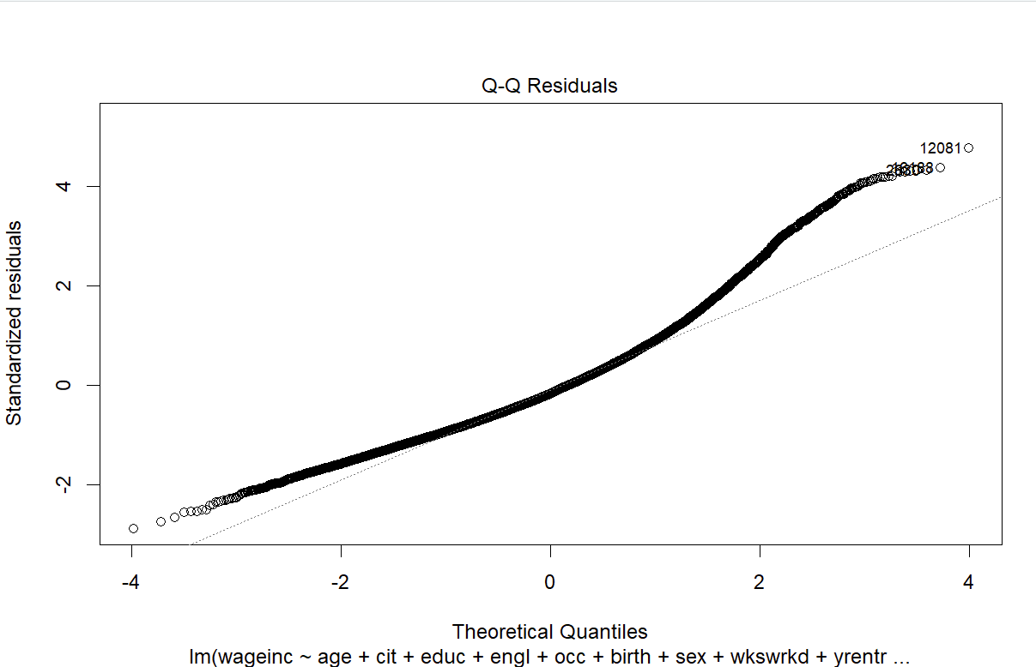
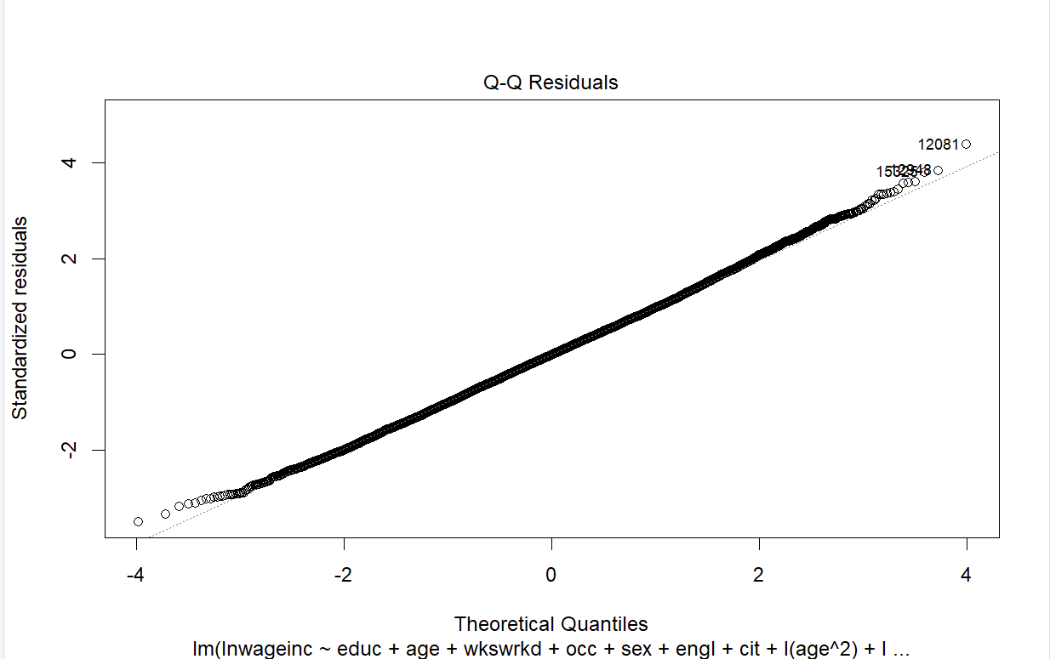
Summary of our Model with Best Predictive Ability
BASE MODEL
REDUCED BEST MODEL

Slide 32
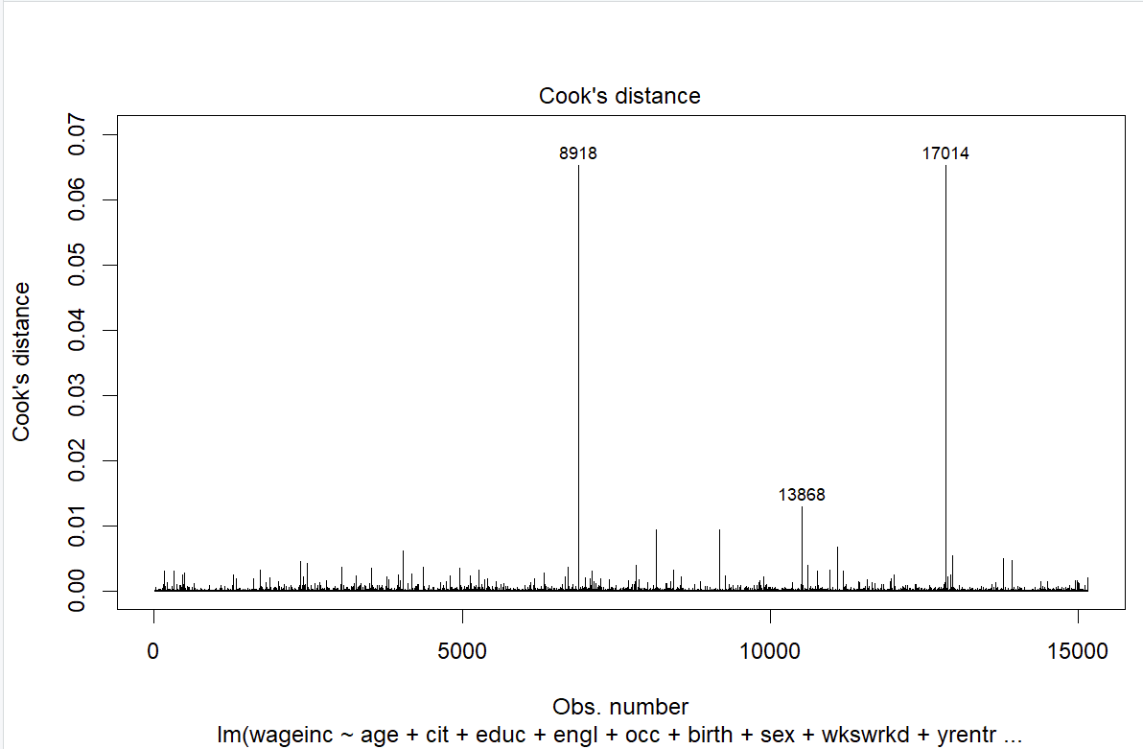
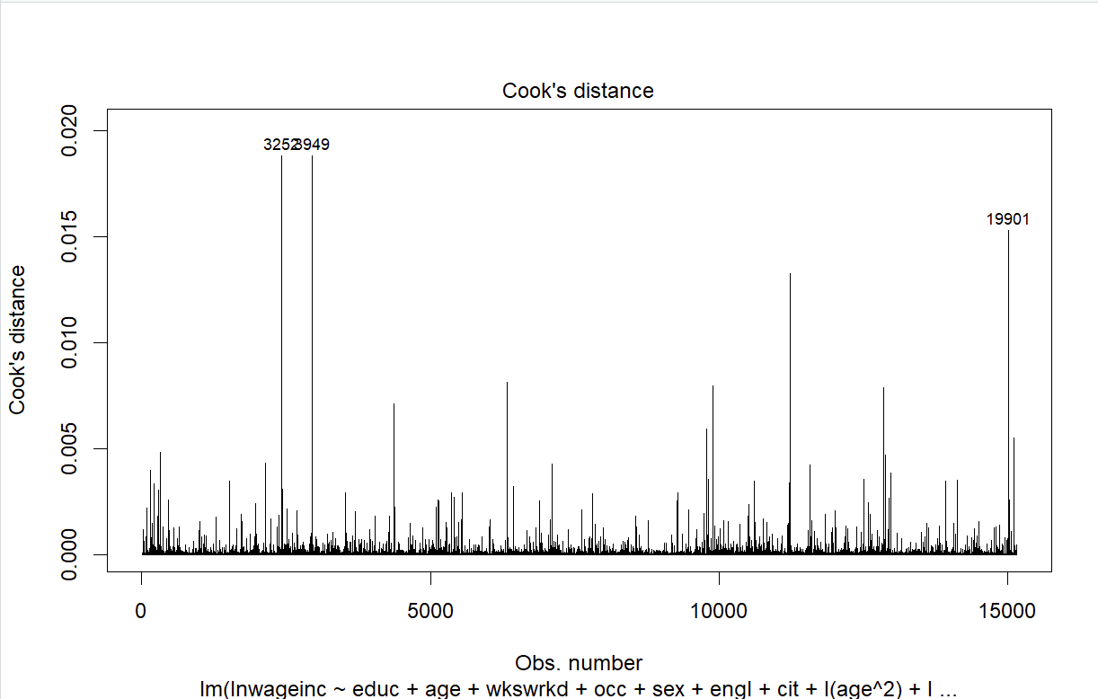
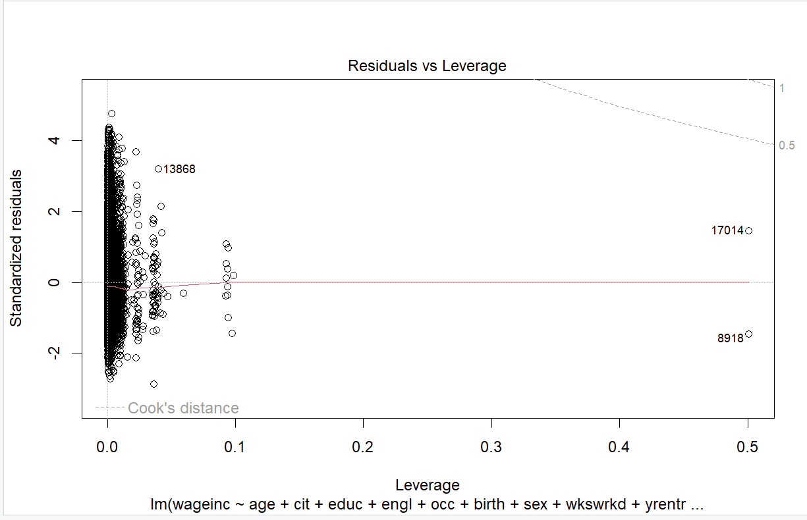
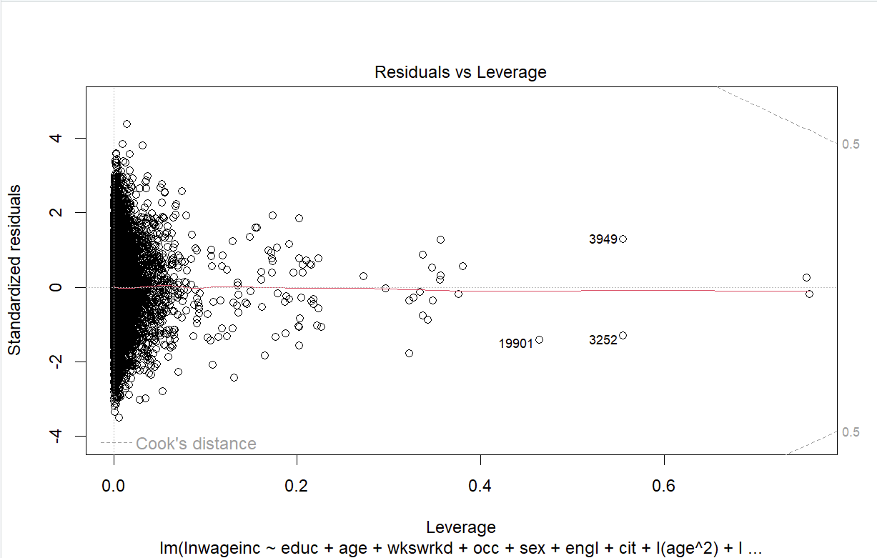
Summary of our Model with Best Predictive Ability
BASE MODEL
REDUCED BEST MODEL

Slide 33
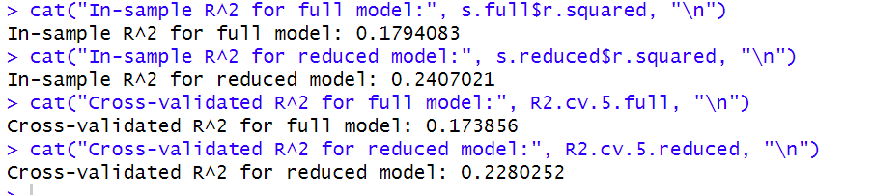
Summary of our Model with Best Predictive Ability
FULL MODEL= wageinc ~age + cit + educ + engl + occ + birth + sex + wkswrkd + yrentry + powspuma
17%
REDUCED BEST MODEL= lnwageinc ~ educ + age + wkswrkd + occ + sex + engl + cit + age^2 + wkswrkd^2 + educ:occ + wkswrkd:occ + age:engl + age:sex + sex:cit + age:cit + educ:sex + educ:age +sex:engl+ occ:cit+ educ:wkswrkd + wkswrkd:engl +wkswrkd:sex
24%
5 FOLD CROSS VALIDATION:

Slide 34
Conclusion:
The reduced model is superior to the base model in terms of:
Explaining variance (higher R-squared values).
Model fit (lower residual standard error).
Predictive capability (via interaction and non-linear terms).

Slide 35
Thank you!

